Slide 1



DEPARTMENT OF INFORMATION TECHNOLOGY
“Touchless Water Dispenser”
Title :
Submit by:
Guided by:
PRAVIN K [REG. NO: 22THO277]
TRAVIDRAJ A [REG. NO: 22TE0060]
VISHWA V [REG. NO: 22TH0316]
NAVEEN MATHIMARAN T [REG. NO: 22TH0267]
Dr. P. SIVAKUMAR M.E., Ph.D
Professor & Head of the Department

Slide 2



1
Abstract
2
existing project
3
proposed work - architecture diagram
4
About the project
Index
5
HARDWARE AND SOFTWARE AND SPECIFICATIONS
6
Conclusion

Slide 3


Abstract

Slide 4



Abstract
The touchless water dispenser is designed to promote hygiene and prevent water wastage by using automation. It detects a container using an IR sensor and measures its height using a motor-controlled system.
Once the height is calculated, the system determines the appropriate fill level. A LiDAR sensor monitors the water level in real-time, and a pump dispenses water only until the desired level is reached.
This project minimizes human contact, making it ideal for public and health-sensitive environments. It combines sensors and automation effectively to deliver a smart, efficient, and user-friendly water dispensing solution.

Slide 5
Existing project

Slide 6
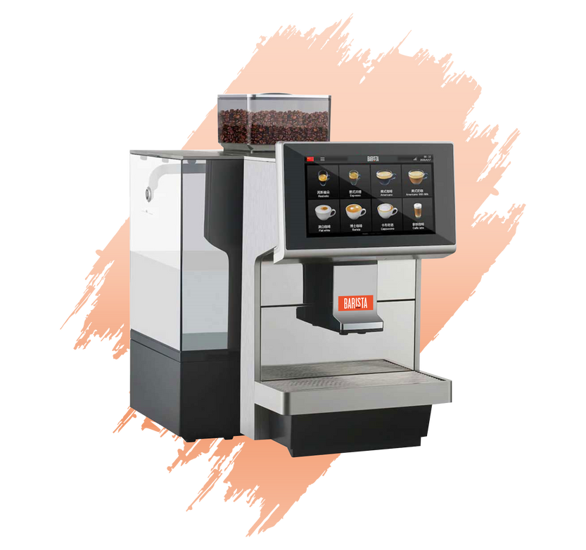
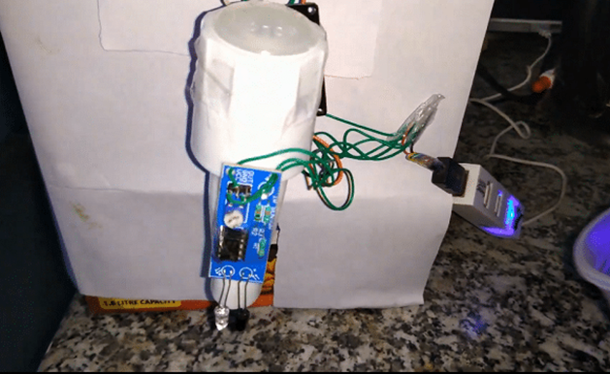
Existing System
2.
Coffee vending machine
1.
IR based water dispenser

Slide 7
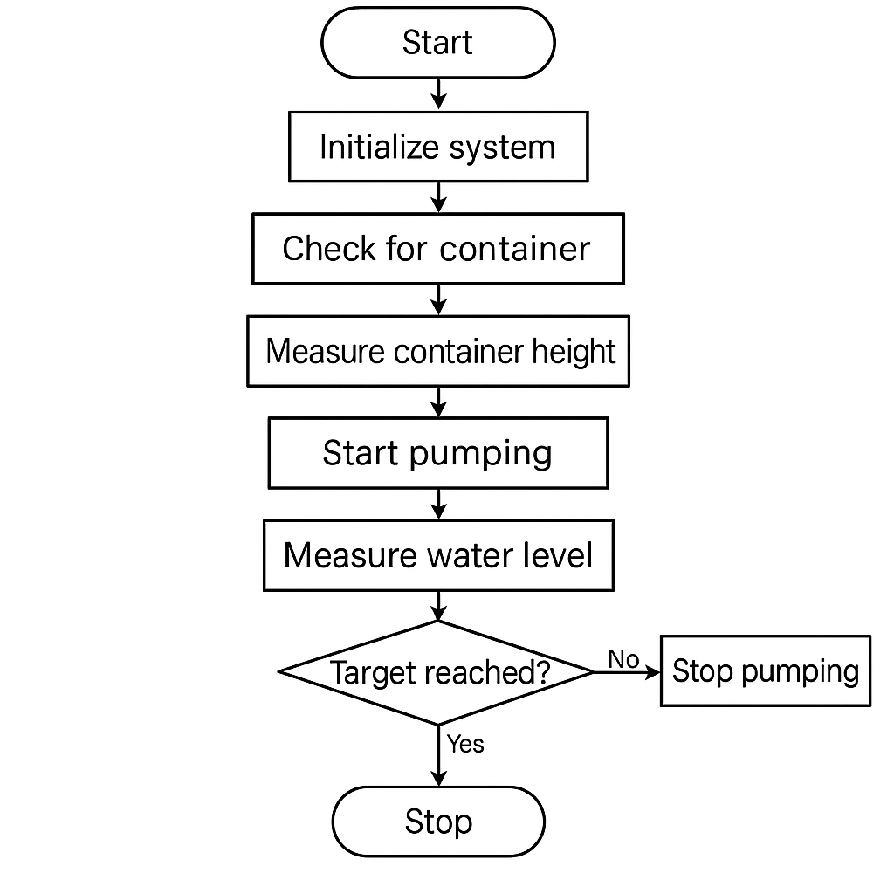
Proposed work - architecture diagram

Slide 8
Workflow
1. When a container is placed, the IR sensor detects its presence.
2. A motor driven platform moves briefly to estimate the container's height using the travel time.
3. The system calculates the target water fill level.
4. The pump activates and fills water while continuously measuring the real time water level using the LiDAR sensor.
5. Once the water reaches the target level, the system stops the pump and signals completion.

Slide 9
About the project

Slide 10
About the project
The Touchless Water Dispenser is designed to automatically fill containers without physical contact. The process begins when the IR sensor detects a container placed under the system. Once detected, the DC motor moves a sensor mechanism to measure the container's height, determining how much water it can safely hold.
After measuring, the VL53L0X LiDAR sensor continuously monitors the water level in the container. The system calculates the target fill level by subtracting the container height from a predefined frame size.
Then, the water pump is activated via the L298N motor driver, and water starts filling the container. As the water rises, the LiDAR sensor checks if it has reached the target level. Once the desired level is achieved, the pump automatically turns off, and the system stops all activity.
This ensures touchless, accurate, and safe water dispensing with minimal human involvement, promoting hygiene and efficiency.

Slide 11







SDG GOAL
Goal 6: Clean Water and Sanitation – Ensures access to clean water through hygienic, touchless technology.
Goal 3: Good Health and Well-being – Promotes public health by reducing germ transmission.
Goal 12: Responsible Consumption and Production – Enhances water conservation and reduces waste.

Slide 12
HARDWARE AND SOFTWARE AND SPECIFICATIONS

Slide 13
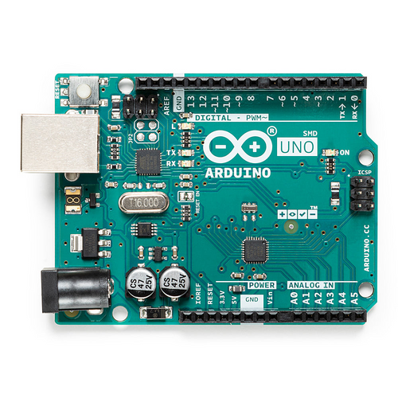
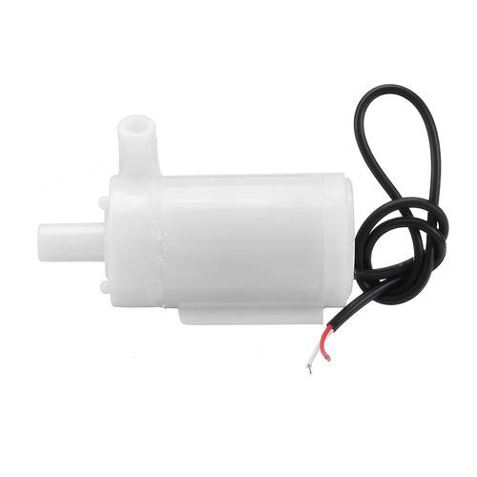
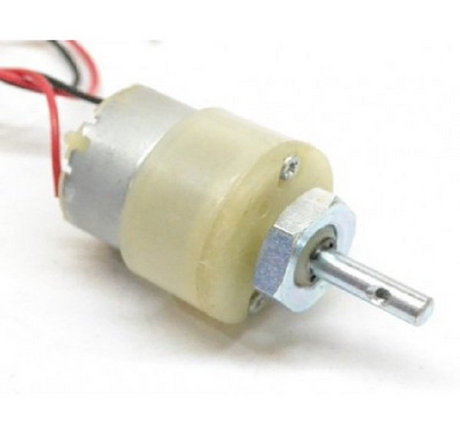
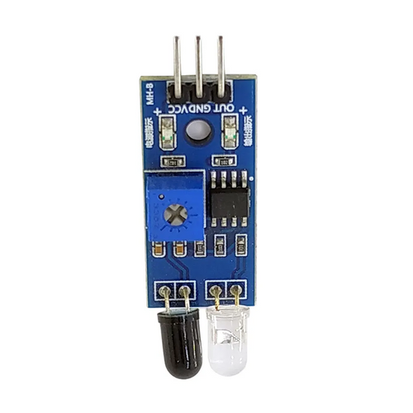
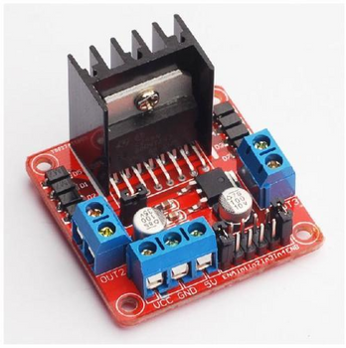
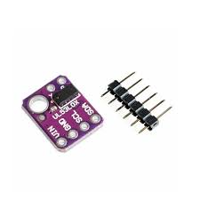
Hardwares:
Arduino Uno
4. Gear Motor 1000 rpm
6. Motor pump
2. IR Sensor
5. Motor driver l293n
3. Li-DAR

Slide 14
Software:
Arduino ide
Adafruit VL53L0X Library
Wire.h Library

Slide 15

Conclusion
The Touchless Water Dispenser project provides a smart, hygienic, and automated solution for water filling. By integrating IR and LiDAR sensors with motor and pump control, the system ensures accurate, contactless operation. It helps conserve water, avoids overflow, and enhances user safety. This innovative approach demonstrates the effective use of automation in everyday utility applications.

Slide 16
Thank You

